Slide 1
HS 200:
Environmental Economics -
An Introduction
Dr. K. Narayanan
Institute Chair Professor
Department of Humanities & Social Sciences
IIT Bombay, Powai, Mumbai 400 076
E mail: knn@iitb.ac.in
24th October 2017

Slide 2
Need of the hour:
Growing recognition to the need to formulate strategies for achieving Sustainable Development.
Developing Countries can benefit being late starters, with proper planning and perspective about “ideal” mix of the use of resources, preservation of their environment and achieve economic development.

Slide 3
Interrelationship
In formulating strategies for achieving sustainable development, the interrelationship between the Economy and the Environment needs to be best understood.
WTO, Globalization and the Environmental concerns
Management of natural resources - Institutions & Enforcements

Slide 4
Course Objectives:
The course aims to provide an overview of the issues involved in planning, policy formulation and implementation for effective conservation and management of the environment.
Issues, both theoretical and practical, that arises in formulating strategic planning for sustainable development, at the micro as well as the macro level will be dealt with.

Slide 5
Inter-disciplinary
The course is inter-disciplinary with special emphasis on environmental economics and socio-economic perspectives in planning and implementation for environmental conservation and pollution management.

Slide 6
The course deals with:
Concepts and issues related to
Economy-environment linkages
Sustainable development
Economic Instruments for pollution control
Design of a policy for industrial pollution control
Climate change impacts
Introduction to the tools and techniques of analysis - transaction costs, cost-benefit analysis, contingent valuation, environmental impact assessment, social impact assessment, etc.

Slide 7
Economy – Environment Linkages
R₁
Goods and Services
R₂
Production
Consumption
Factors of Production
E₁
_{Energy}
_{And}
_{Materials}
E₂
_{Waste}
_{Sink}
E₃
_{Amenity}
E₄ GLOBAL LIFE-SUPPORT SERVICES

Slide 8
Circular flow
Two sector economy – Consumption [households] and Production [businesses]
Exchange of goods, services and factors of production take place between these two sectors
Environment is shown in two ways:
  As the three interlinked circles E1, E2, & E3.
  All-encompassing boundary labelled E4.

Slide 9
Production sector extracts energy resources [such as oil] and mineral resources [iron ore] from environment.
These are transformed into output, useful and waste [SO2]
There is some recycling of resources within the production sector, shown by R1, and within the consumption sector R2.

Slide 10
Role of environment
1. Supplier of resources
2. Sink, or receptor, for waste products
  Wastes can be biologically and/or chemically processed by the environment
    Whether harmful depends on volume of waste, temparature, rate of replacement, etc [in an estuary for example]
      Limited assimilative capacity ??
        “Threshold” effect

Slide 11
For some inputs to the environment, there are no natural processes to transform them into harmless, or less harmful, substances.
  Cumulative and conservative pollutants like metals such as lead and cadmium, man-made substances such as PCBs [Polychlorinated biphenyls] and DDT [dichloro-siphenyl-tricholoroethane]
  bioaccumulation

Slide 12
Environment as a supplier of amenity, educational and spiritual values to society.
  People in Europe may derive pleasure from existence of wilderness areas in Northern Canada or in tropical moist forests [“rainforests”]
  Himalayas
  Theory of environmental valuation

Slide 13
Conflicts in resource use
Using a mountain region as a source of minerals means its amenity value is reduced
Using a river as a waste-disposal unit means its amenity value is reduced and that we can no longer extract so many material resources [fish to eat] from it
Felling a forest for its timber reduces the electricity-generating capacity of a dam, owing to soil erosion, and reduces amenity values since the forest’s inhabitant [animal and human] are displaced or destroyed
Preserving a wetland for its aesthetic qualities forgoes use of the drained land for agriculture

Slide 14
Does rising output means rising energy use?
As economic growth occurs, energy and material demands per real dollar of output have tended to fall:
  France, Germany, Japan and UK
  Most of the reduction in the energy/real GDP ratios in these countries is accounted for by changes in the composition of energy use [away from coal and towards petroleum and nuclear sources]

Slide 15
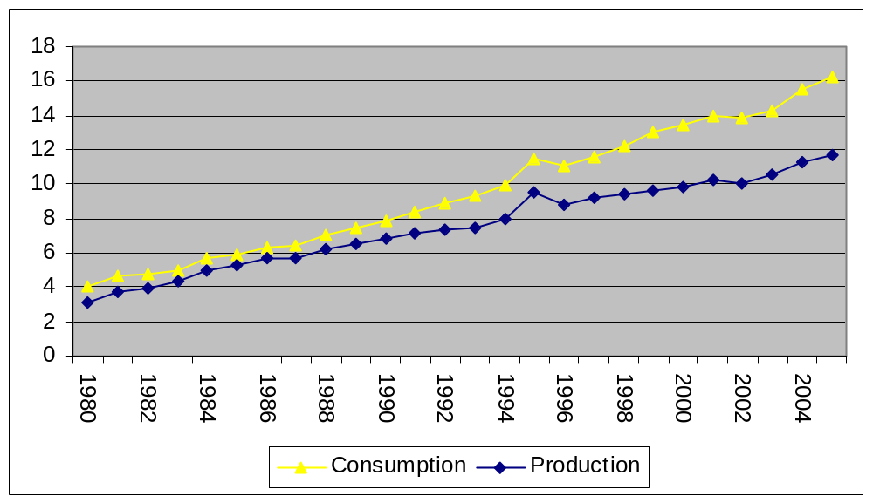
Primary total energy Consumption and Production (1980-2005) in India

Slide 16
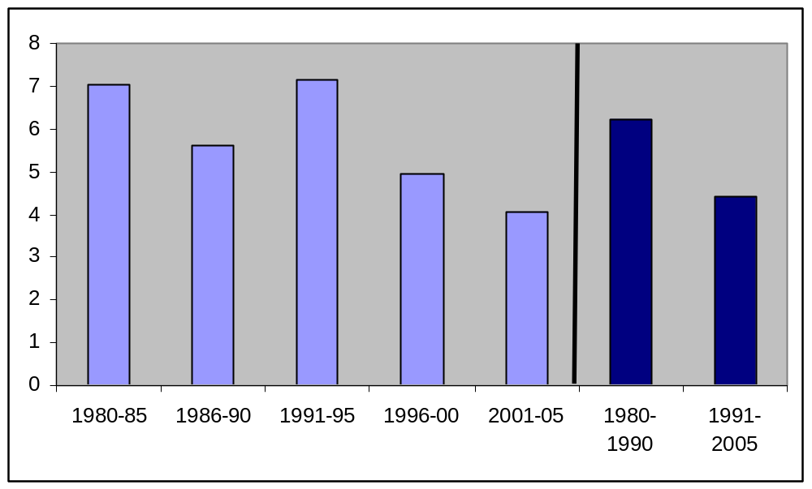
Growth rate of energy consumption in India from 1980 to 2005 at different time period

Slide 17
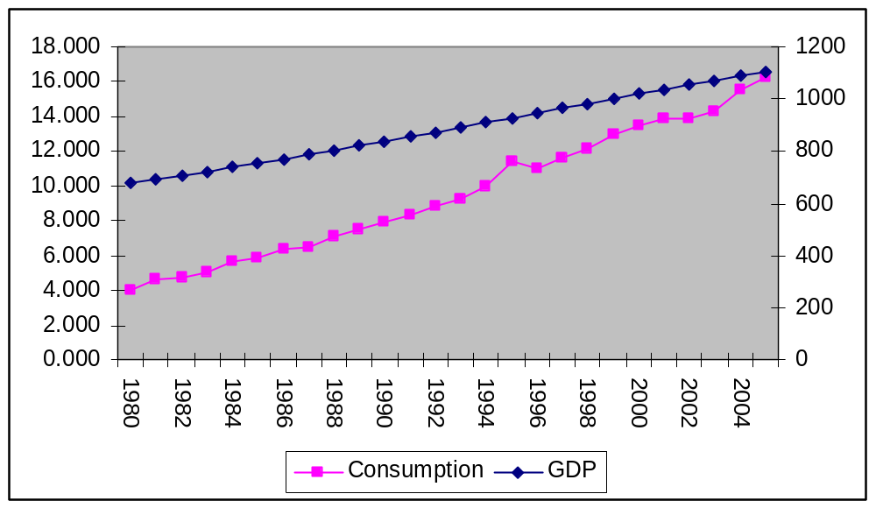
Total Energy consumption and GDP from 1980 to 2005 in India

Slide 18
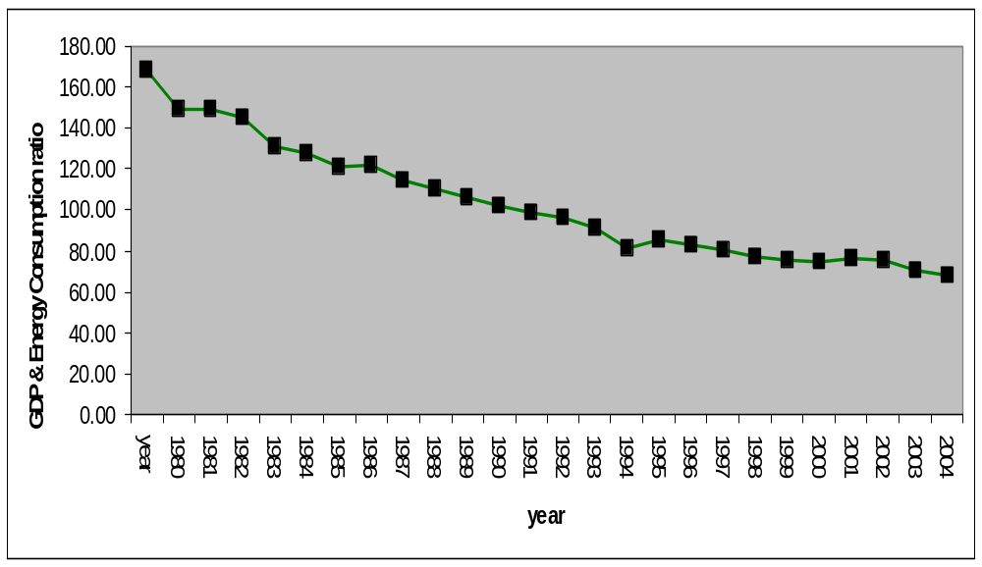
GDP & Energy Consumption ratio: Case of India

Slide 19
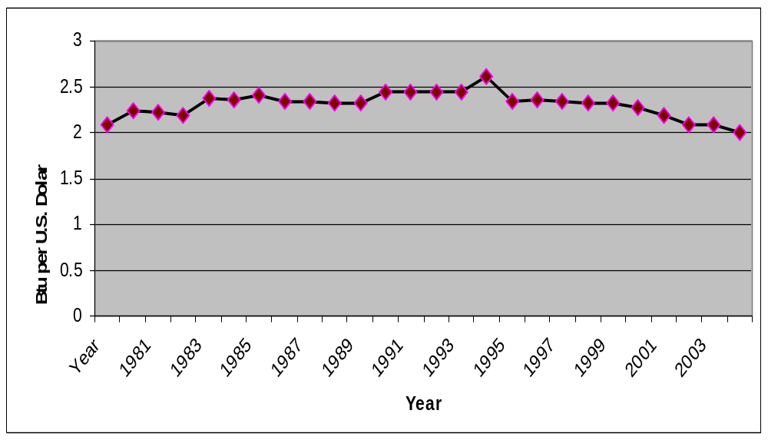
Total Primary Energy Consumption per Dollar of Gross Domestic Product: Case of India

Slide 20
E4 –global life support services
Maintenance of an atmospheric composition suitable for life
Maintenance of temperature and climate
Recycling of water and nutrients.

Slide 21
The first two laws of thermodynamics
Two important physical laws and their relevance for the way we view the interrelationships:
First two laws of thermodynamics, hold true in strictly closed systems, i.e., systems with no external inputs.

Slide 22
First law
Matter, like energy, can neither be created nor be destroyed.
Materials balance principle.
implications
As more matter is extracted by the production process, more waste is generated which must eventually be returned to the environment, since the matter-energy content of the extracted material cannot be destroyed.
It places limits on the degree to which resources can be substituted for each other in production.

Slide 23
Second law
Known as entropy law:
In a closed system, the use of matter-energy causes a one-way flow from entropy resources to high entropy resources’ from order to disorder.
for energy, the amount of work that energy can do is diminished.
However, while it is useful to understand recycling, it is not necessarily the harbinger of doom.

Slide 24
The Broad contours of
Environmental Economics
Micro Economics
Macro Economics
Deals with the behaviour
of an individual, a firm
and/or markets
Policies to correct
market failure
Deals with aggregates –
economy as a whole
Monetary, Fiscal and
Trade Policies

Slide 25
Micro Economic Issues include:
Theory of Public Goods
Externalities & Market Failure
Cost Benefit Analysis
Environmental Policy
Environmental Audit

Slide 26
Macro Economic Issues include:
Economic Growth and Environment
WTO, Globalization and Environment
Management of natural resources Institutions & Enforcements
Valuation of Environmental Resources
Energy-Ecology Linkages & Modelling
Environmental / Natural Resources accounting

